Slide 1
Pathfinder overview
Interuniversity project
GA Tech
BYU
CU Boulder
Hardware demos
Estimation
Planning
Tasking

Slide 2
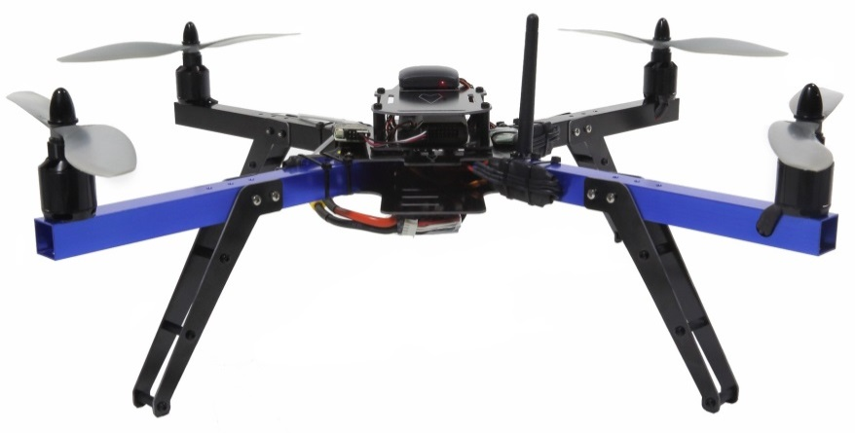
Pathfinder hardware
Summer 2014 dev on PX4 autopilot
Estimator
Controller
Hardware wishlist
3DR Y6 hexcopter
3DR quadrotor
AR.drone with PX4 autopilot
Structure sensor (mini-Kinect)
Nice camera for mono-SLAM
..
https://store.3drobotics.com/products/apm-3dr-quad-rtf

Slide 3
Cooperative estimation
Cooperative feature-based localization
Measured agent-agent relative vector
Feature range & bearing, bearing only
m_{j}
m_{i}
j
i

Slide 4
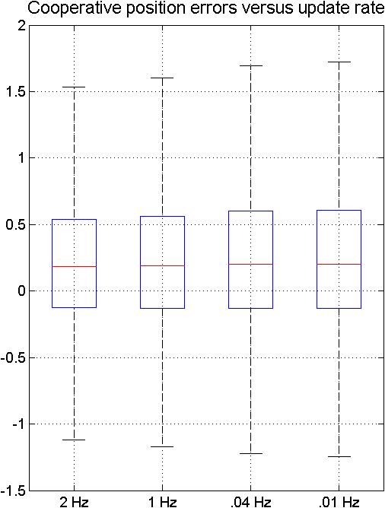
Future work
Future directions
Backend/batch smoother
IMU sharing
Hardware demos
Other future directions
Unknown features (cSLAM)
Path planning
Cooperative maneuvers
University-university collaboration

